Slide 1
Introduction to Computation
Fan Cheng Shanghai Jiao Tong University
http://www.cs.sjtu.edu.cn/~chengfan/
chengfan@sjtu.edu.cn
Autumn, 2022

Slide 2
Outline
Class
Module

Slide 3


清晰、有条理、减少bug

Slide 4
Module, Class and Function: WHY?
Microsoft’s Win10 has over 50,000,000 lines of codes
Name conflicts in variables and functions
How to cooperate with other programmers
How to maintain such a huge project
We need a mechanism to deal with the complicated problems in real world.
How to mange a city with a population of 26,000,000 (e.g., Shanghai)
分而治之：中央政府—省—市
相互协作：各级机构协作
In Python
Divide and conquer: module – class – data and function
文件操作、网络模块、数据库、操作系统、科学计算
Collaboration: modules can call each other and reuse their codes
根据问题的需求，将数据和函数包装成类，把相关的类打包成模块

Slide 5

Class and Object
物以类聚，人以群分
类class，对象object，实例instance
Python自带的类: str, int, float, list, tuple, dict, set
a=“hello” # a 是str的一个对象(实例)
b=123 # b 是int的一个对象
c=[1, -1, [1]] # c 是list的一个对象
d={1,2,3} #d 是set的一个对象
类(class)：具有相同属性(attribute)和行为(method)的个体的集合
类的一个实例(instance)叫做对象(object)：
类和对象的关系: 集合与个体。
中国人：姚明。动物：狗。狗：哈士奇
类：打包封装 数据+函数

Slide 6
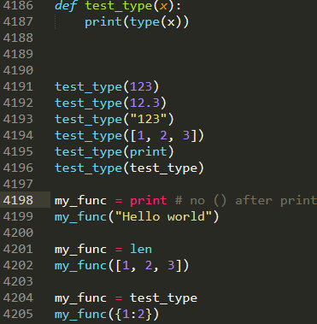
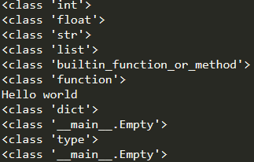
Class and Type
Values have their own types
Variables are defined by “=”: assignment expression
The type of a variable could be changed in python
Functions are also a kind of data

Slide 7
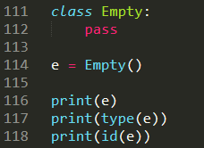

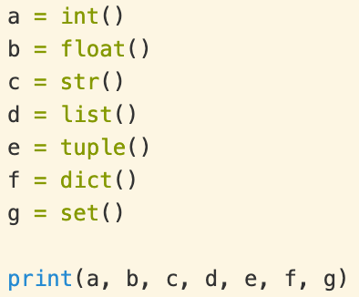

Keyword: class
class ClassName:
# begin your code here
Initialize an object: x = ClassName()
Class Empty is the simplest class. All its details are default by python

Slide 8
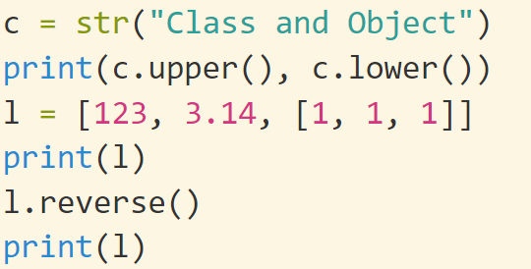
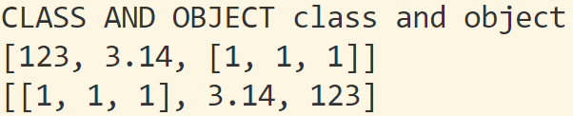
Class
Class := attributes + methods
Attribute：属性(变量)，数据，例如三角形的三条边长度
Method：方法(函数)，处理数据的各种函数，例如计算面积，计算各个角度，计算外接圆、内切圆等等
area(), angles()……
class Triangle:
……
Usage of attributes and methods: object.attr or object.method()
x = Triangle() print(x.a) print(x.area())
y = Triangle() print(y.a) print(y.area())
(x, y 表明范围, a和area表明操作)
上海市.闵行区.东川路.800号
. : 表示从属关系

Slide 9
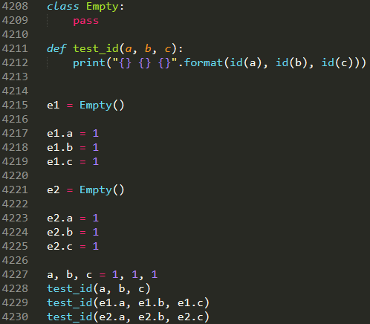
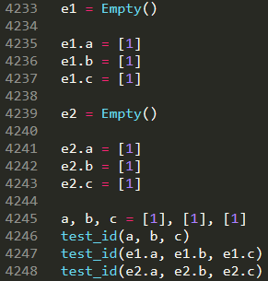



“.” operator
x.y: y is a variable inside the scope of x. “.” could distinguish x.y from the y outside x
x.y could also be defined by “=’
对象内部的属性和外部的属性互不干扰
对象之间的属性也互不干扰
Line 4215-4230，line 4233-4248: 1是不可修改对象，[1]是可修改对象，系统为了节约内存，有时候会共用不可修改对象。可修改对象一定不会共用
e1, e2 都通过”.”添加了内部的变量a, b, c. e3没有添加，所以e3报错
如果我们需要所有Empty的对象都自动具有a, b, c三个属性呢？？

Slide 10
Class: Challenge
合理设计类的机制, 需要解决的问题：
如何保证同一个类所有的对象都具有相同的属性和方法
狗都有一双眼睛(eyes)、四条腿(legs)，一条尾巴
class Doge
如何共享程序: 方法(函数)调用
red_doge, white_doge, red_doge.bite(), white_doge.bite()
不同的对象互相不干扰，独立运行
调用bite()时，知道是white_doge还是red_doge
如果bite()含有参数，知道是哪个参数
使用legs时，知道是谁的legs
构造函数__init__(): 保证统一性
self，用来区分不同对象

Slide 11
Class design: __init__(self) 构造函数
def __init__(self): “__init__(self)” is a reserved method in python classes. All classes contain the __init__()
This method is called automatically when an object is created from the class and it allow the class to initialize the attributes of a class
It is known as a constructor (构造函数) in object oriented concepts.
Use the __init__() function to assign values to object properties, or other operations that are necessary to do when the object is being created
1. __init__()在对象定义时自动调用，保证了所有的对象都具有相同的属性
2. __init()__函数传递的参数的不同，同一类对象属性的值不同
class ClassName
__init__(self, paramters)
……
__init__(): 以两个连续下划线 “_ _” 开始和结束
init：initialization的缩写

Slide 12

Class: self
Self: myself, yourself, themselves ……
The first parameter in __init__(self) must be self
When define an object, self will point to this object
white_doge = Doge() # self = white_doge
red_doge = Doge() # self = red_doge
__init__(): 保证统一性，self保证唯一性
类的定义在程序里面也只是一段代码，只有具体定义一个对象时，才会使用。Self保证了程序可以区分开是哪个对象 (white_doge or red_doge)
定义: x = ClassName()
隐含: self = x
class ClassName
__init__(self, parameters)
……
self不是keyword，可以用其它单词(this)代替它，但习惯上都用self.
第一个参数默认是self, __init__()没有参数会报错
定义对象的时候，不用用户传递self，系统会自己传递 (参数数量会少一个). 调用没有self的函数会报错

Slide 13
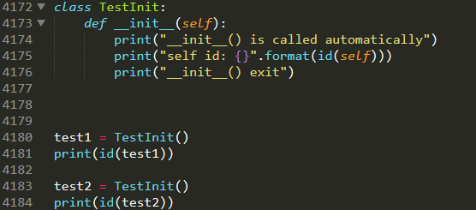
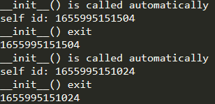
__init__() and self
1. __init__()被自动调用
2. 定义: x = ClassName()
隐含: self = x
对象和对象之间会共享函数，所以self保证了函数运行的正确性

Slide 14
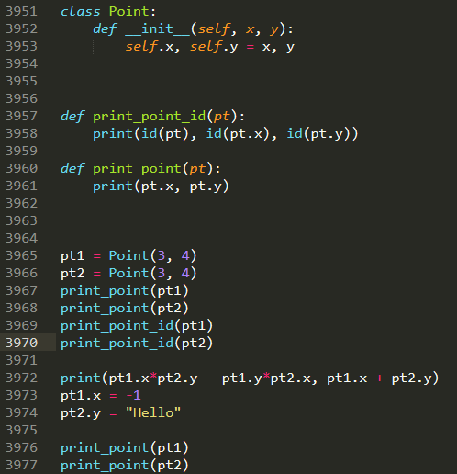



Member Attributes
3953：”=” 定义变量
3965： self = pt1
3966: self = pt2
x, y是参数，self.x和self.y 表示将定义的对象的x 和y
Line 3965, 3966只有两个参数
Line 3965—3970, pt1 and pt2 have the same position. Their address are different
Line 3972—3977, you may use the attributes like general variables
Line 3952 Vs. Line 3965, __init__ has 3 parameters. When initialize an object, self is not needed
__init__ will be called when the object is created

Slide 15
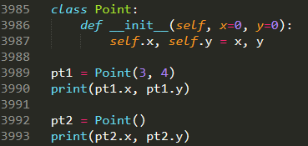

Class Point: default parameters

Slide 16
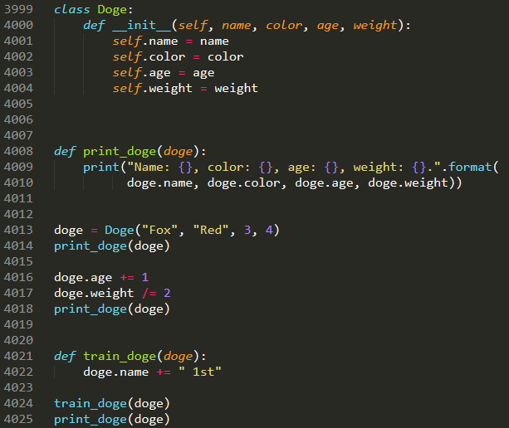

Class Doge

Slide 17
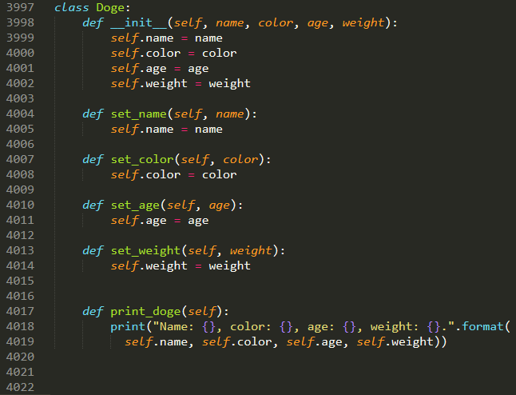
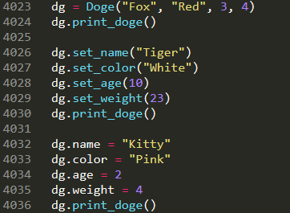

Member functions
Member functions: the same with the general function definition, except that the first parameter should be self
When called member functions, self is omitted
不建议4032—4036这种写法

Slide 18
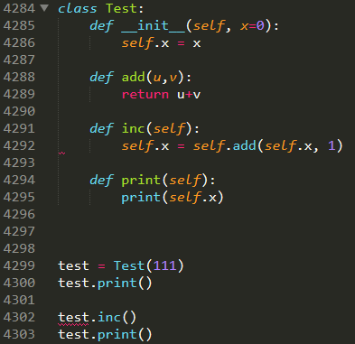
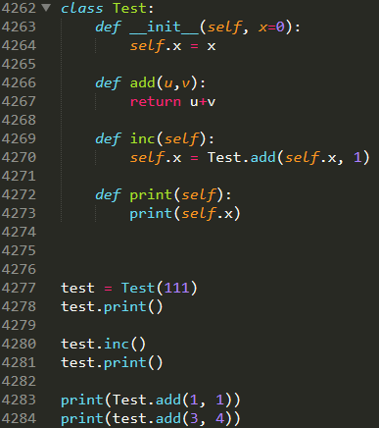

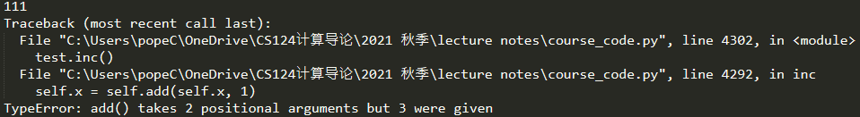
Member functions: no self
Member functions without self cannot be called by an object, but called inside the class implementation via: ClassName.func()
Line 4284, error: add is not a function of self
Line 4288, u=self

Slide 19
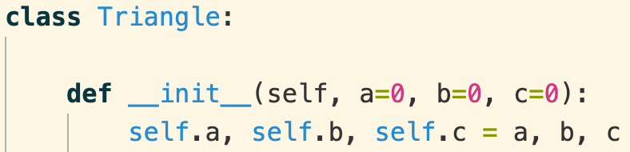
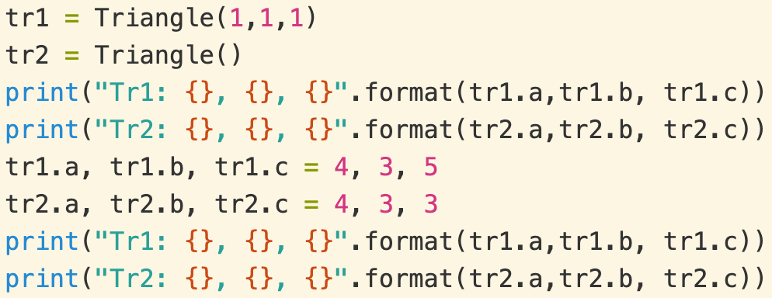
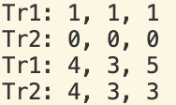
Class Triangle, self
同一个类的不同对象
属性、方法独立，互相不干扰
__init__: 表明所有的Triangle对象都有a, b, c三个属性，并且默认为0.
Q: 为什么有个self？为什么__init__()有四个参数，而tr1, tr2定义时只传递了三个参数
不同对象的属性，保存在不同的内存位置: tr1.a, tr2.a
为了节省内存空间。同一类的不同对象，共享方法(函数)的空间。执行的时候，都是跳转到同一段代码。问题：严重干扰，如何区分a是属于tr1还是tr2
self是一个隐藏参数，当定义对象时，self被自动指向该对象
tr1 = Triangle(1,1,1) # 系统默认 self=tr1
tr2 = Triangle() #系统默认 self=tr2
类的方法调用的时候，self会自动传递过去
没有self的函数无法使用，使用会报错：参数数量不匹配
在类中使用属性和方法时，前面必须加self: self.xxx, self.xxx()
self.x 和x，self.f()和f()是不同的方法和属性
tr1, tr2是两个独立的对象，虽然属于同一个类
Tr1, tr2的属性和方法都可以直接使用，和普通变量一样
. 运算符：表明作用范围

Slide 20
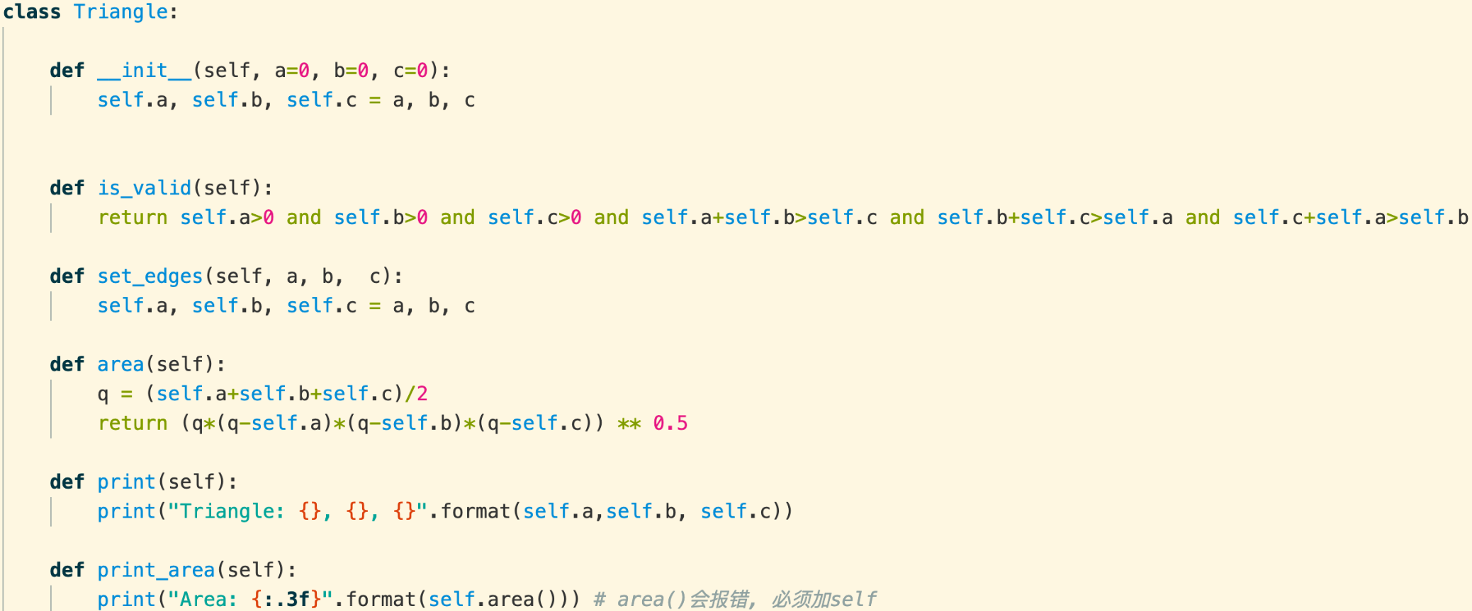
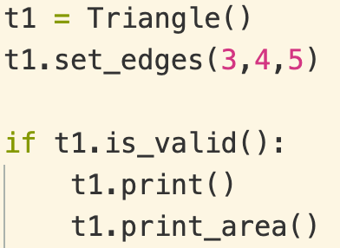

Class Triangle
1. 类的成员函数和普通函数的定义一样，除了第一个参数是self
2. 类方法的执行规律和普通函数一样， 除了不需要传递self进去
3. 函数内使用成员属性，必须加self.
使用类自己的函数或者属性时，必须加self.

Slide 21
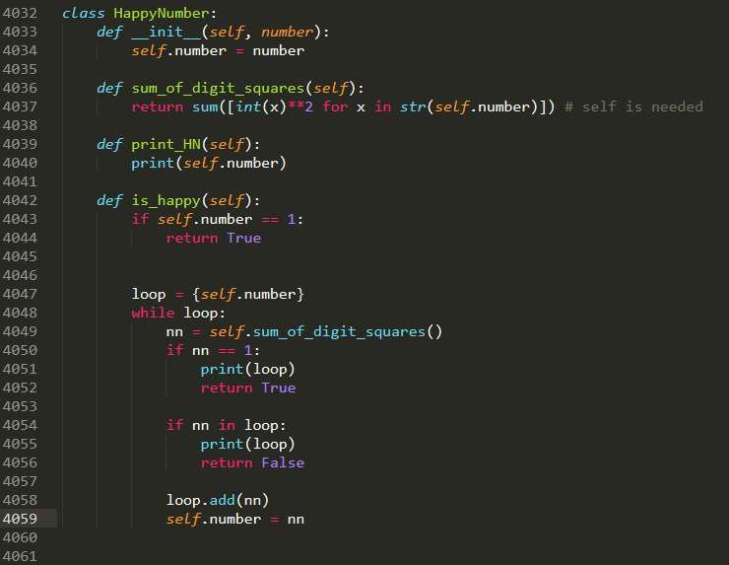
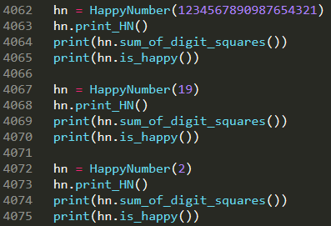
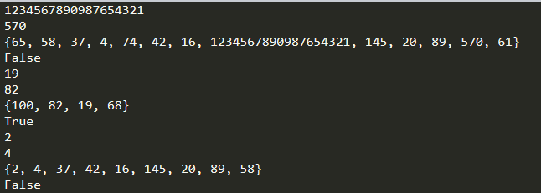
Class HappyNumber
A happy number is a number defined by the following process:
Starting with any positive integer, replace the number by the sum of the squares of its digits.
Repeat the process until the number equals 1 (where it will stay), or it loops endlessly in a cycle which does not include 1.
Those numbers for which this process ends in 1 are happy.

Slide 22
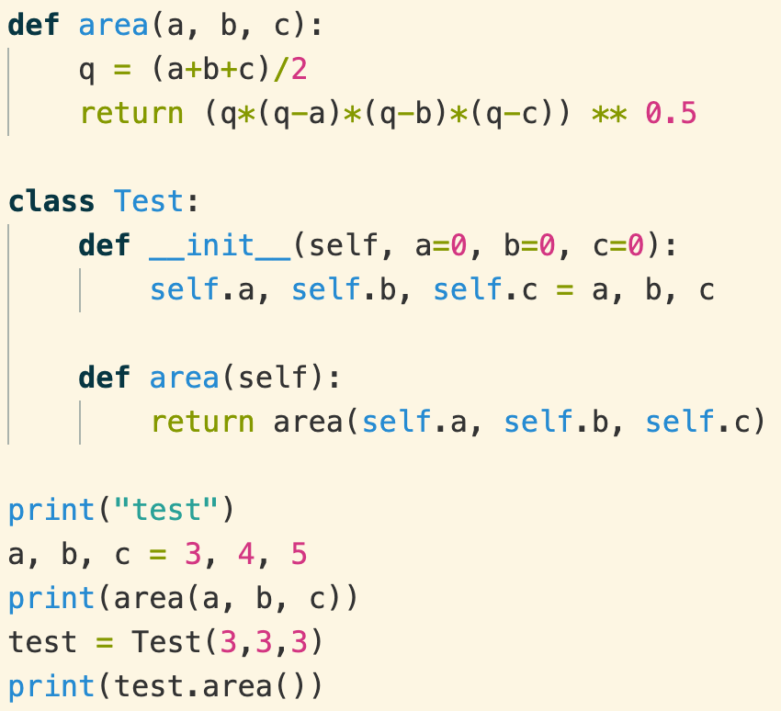

Scope of functions and variables
area()和xxx.area()是两个函数
类里面的函数要加self
不同作用范围的两个物体是隔离的

Slide 23
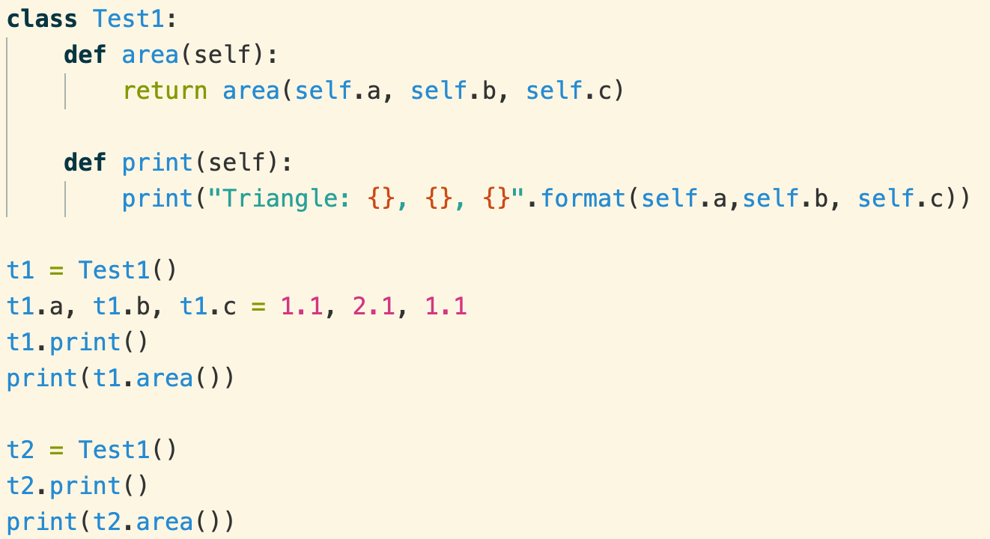
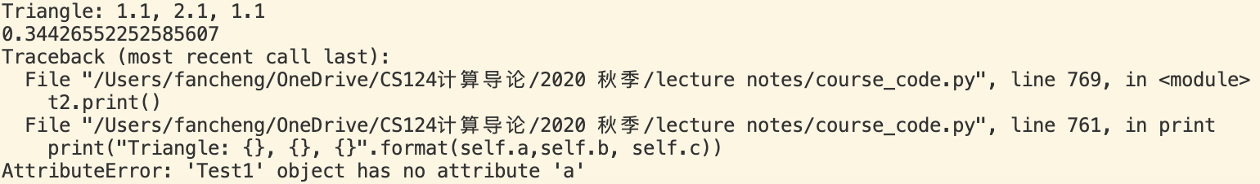
Without __init__
没有__init__()函数
类Test1的对象没有共同的属性
Python自动推导变量的类型
t1有自己的的属性a, b, c
t2没有属性a, b, c

Slide 24
Python classes/objects
Python is an object oriented programming language
Almost everything in Python is an object, with its properties and methods
A Class is like an object constructor, or a "blueprint" for creating objects
Procedural programming paradigm: write functions that operate data
Python is an object-oriented Programming (OOP) Language
OOP has its root in 1960s. In 1980s, it became the main programming paradigm
Rapid growing software size and complexity
The focus is object that contains both data and functionality
Each object definition corresponds to some object or concept in the real world, and the functions that operate on that object correspond to the ways real-world objects interact
Commonly known OO Languages: C++, Java, Python
Class and object
For more details: https://en.wikipedia.org/wiki/Object-oriented_programming
如果没有OO，所有东西都写在一起?

Slide 25
Exercise
实现Triangle类
实现vector类
属性：一个n维的list
方法
长度length(self)
print_length()
方向angle(self)
Print_angle()
点积dot(self, other)
伸缩scale(self, ratio)

Slide 26
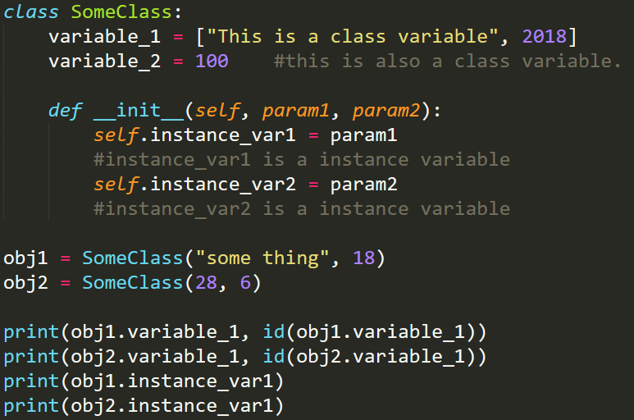
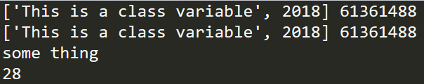
Class Variables
In general, instance variables are for data unique to each instance and class variables are for attributes shared by all instances of the class:
所有人都有自己的姓名(instance)，但只有一个国籍(class)

Slide 27
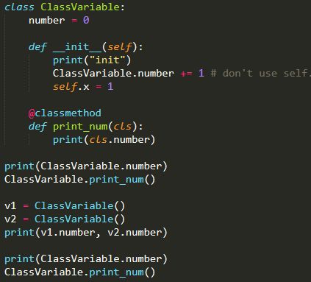

Class Variable VS Instance Variable
Instance variables/methods are owned by the instance itself. No interference!
You must define an instance first to use them
Class variables/methods are shared by all instances of the class
To use a class variables/methods, you don’t need to define an instance first
类属性/方法：类的所有对象共享同一份
不用实例化对象
实例属性/方法：各个对象各有一份
类对象/函数实例化之前就可以使用
Classname.xxx

Slide 28
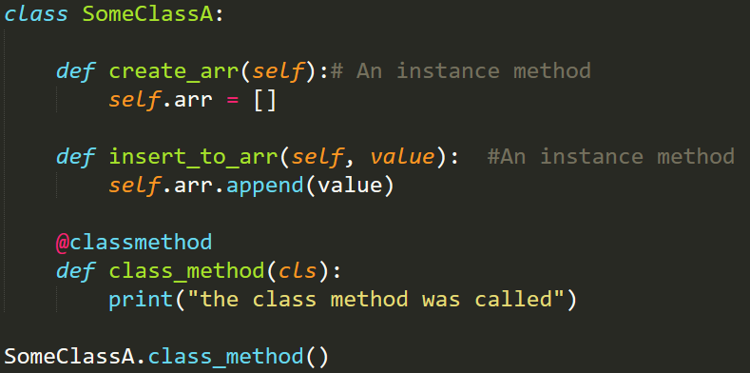
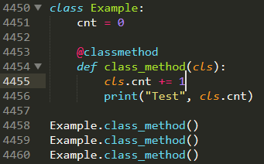

Class Methods
Class methods are methods shared by all instances of the class. Without even instantiating an object, we can access class methods

Slide 29
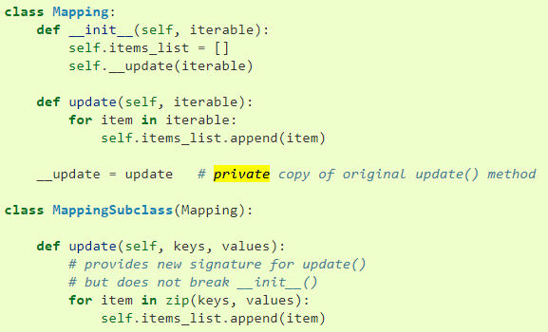
Private Methods
“Private” instance variables that cannot be accessed except from inside an object don’t exist in Python.
However, there is a convention that is followed by most Python code:
a name prefixed with an underscore (e.g. _spam) should be treated as a non-public
part of the API (whether it is a function, a method or a data member). It should be
considered an implementation detail and subject to change without notice.
non-public: 不建议(禁止)使用

Slide 30

Evolution and Inheritance (继承)
继往开来
往：父类
来：自己的特色
Inheritance: Classes can inherit from other classes
A class can inherit attributes and behaviour methods from another class, called the superclass (父类). Superclasses are sometimes called ancestors as well
A class which inherits from a superclass is called a subclass (子类), also called heir class or child class
Evolution: Subclass may have their own attributes and methods
Evolution and Inheritance: code reuse

Slide 31
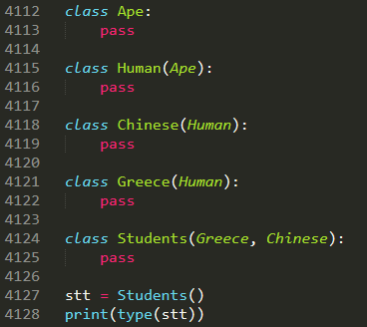
Machinery of attribute inheritance
The net effect—and the main purpose of all this searching—is that classes support factoring and customization of code better than any other language tool we’ve seen so far. On the one hand, they allow us to minimize code redundancy (and so reduce maintenance costs) by factoring operations into a single, shared implementation; on the other, they allow us to program by customizing what already exists, rather than changing it in place or starting from scratch.

Slide 32
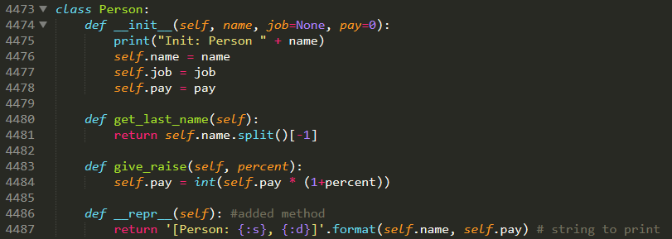
__str__() for print()
Person类
属性：name, job, pay
方法：get_last_name(), give_raise(), __repr__()
TODO: Manager类
继承Person: 具有Person的所有属性和方法
自己的方法和属性

Slide 33
Machinery of attribute inheritance
Superclasses are listed in parentheses in a class header. To make a class inherit attributes from another class, just list the other class in parentheses in the new
Classes inherit attributes from their superclasses. Just as instances inherit the attribute names defined in their classes, classes inherit all of the attribute names defined in their superclasses
Instances inherit attributes from all accessible classes. Each instance gets names from the class it’s generated from, as well as all of that class’s superclasses. When looking for a name, Python checks the instance, then its class, then all superclasses.
Each object.attribute reference invokes a new, independent search. Python performs an independent search of the class tree for each attribute fetch expression.
Logic changes are made by subclassing, not by changing superclasses. By redefining superclass names in subclasses lower in the hierarchy (class tree), subclasses replace and thus customize inherited behavior.

Slide 34
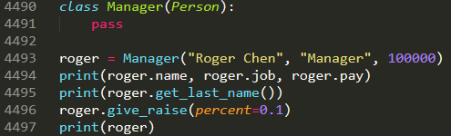

Inheritance Syntax
The syntax for a subclass definition looks like this:
class DerivedClassName(BaseClassName1, BaseClassName2, … ):
……
继承：拥有父类所有的属性和方法

Slide 35
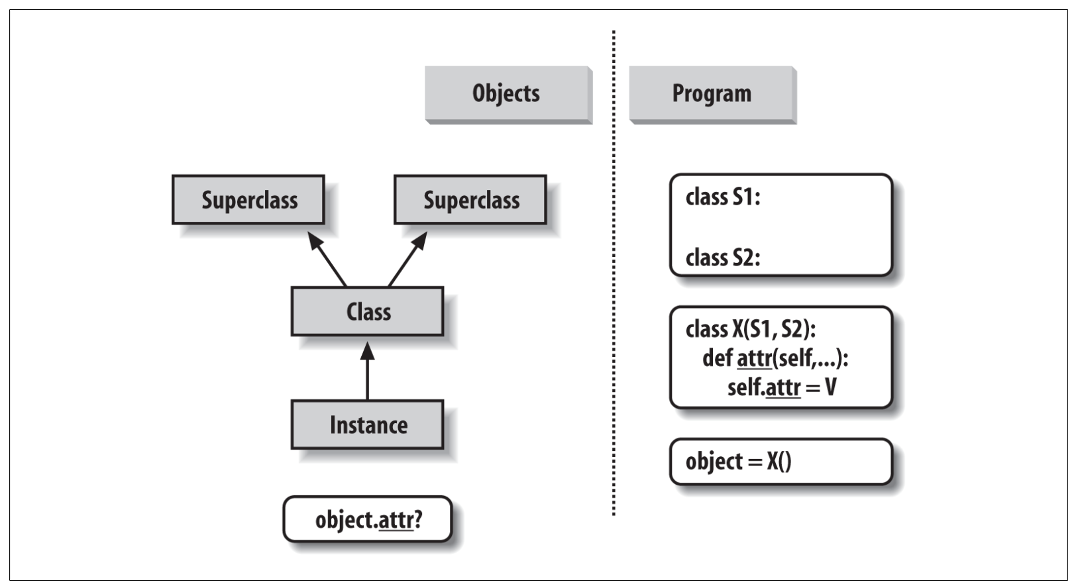
Inheritance Tree
Instance attributes are generated by assignments to self attributes in methods
Class attributes are created by statements (assignments) in class statements
Superclass links are made by listing classes in parentheses in a class statement header
The net result is a tree of attribute namespaces that leads from an instance, to the class it was generated from, to all the superclasses listed in the class header. Python searches upward in this tree, from instances to superclasses

Slide 36
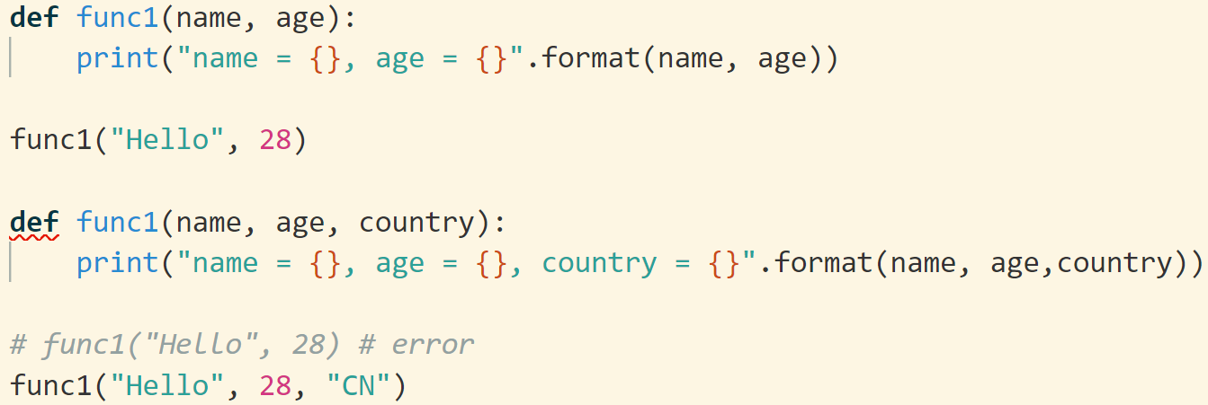

Functions with the same name
Python中，函数必须在使用前定义
Python中，两个同名函数， 无论参数是否相同，后面的函数会覆盖前面的函数。即，python中没有重载，只有重写

Slide 37
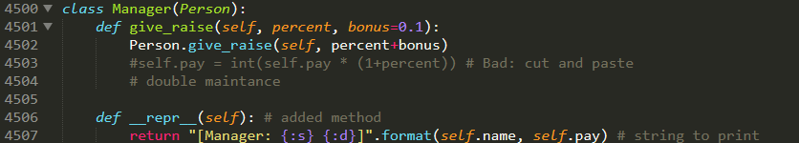


Overriding (重写)
Method overriding is an object-oriented programming feature that allows a subclass to provide a different implementation of a method that is already defined by its superclass or by one of its superclasses
The implementation in the subclass overrides the implementation of the superclass by providing a method with the same name as the method of the parent class
super().giveRaise()可以起到和Person.giveRaise()相同的功能，但是不推荐用super()
Person.giveRaise()比super更清晰
一个类可以继承多个类，super()有歧义
重写：子类覆盖父类
“年轻人有自己的想法”

Slide 38
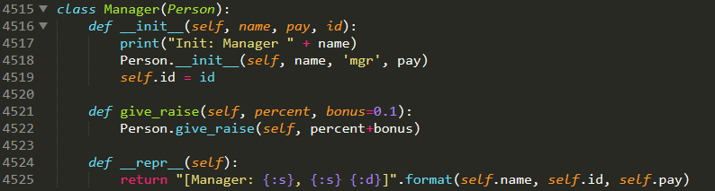


Overriding __init__()
To add new members to the attributes.
注意：删除Person.__init__(self, name, 'mgr', pay)则manager将没有name, job, pay.

Slide 39
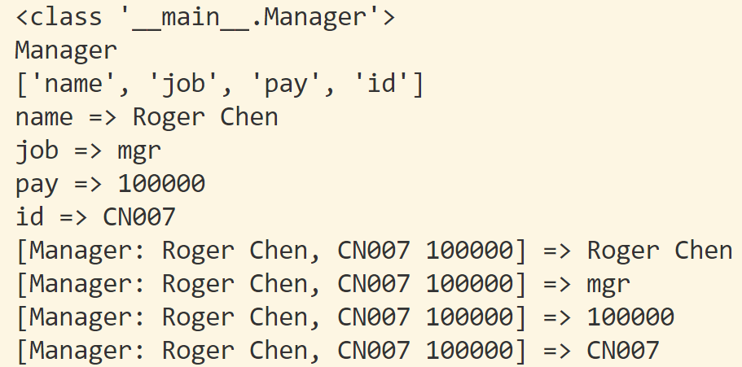
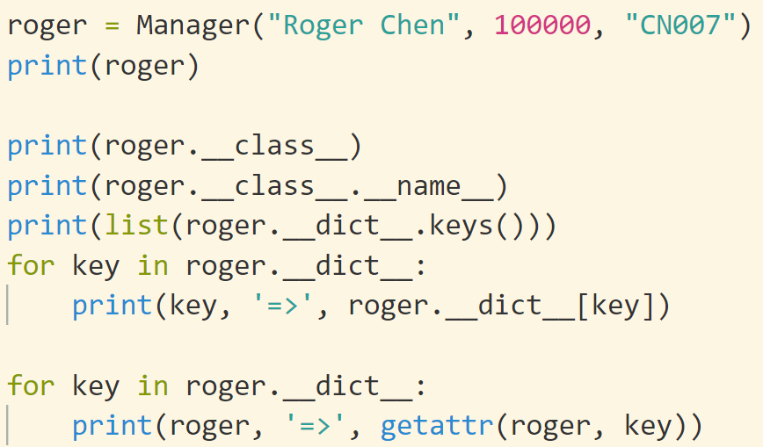
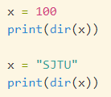
Introspection Tools
Special attributes and functions that give us access to some of the internals of objects’ implementations.
The built-in instance.__class__ attribute provides a link from an instance to the class from which it was created. Classes in turn have a __name__, and a __bases__ sequence that provides access to superclasses.
The built-in object.__dict__ attribute provides a dictionary with one key/value pair for every attribute attached to a namespace object (including modules, classes, and instances). (dir() for functions)

Slide 40
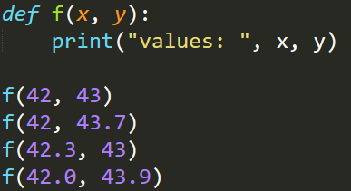
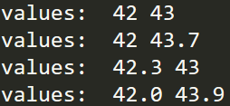
Polymorphism (多态)
基本原理：Inheritance Tree
Tree-searching model of inheritance
Because inheritance finds names in subclasses before it checks superclasses, subclasses can replace default behavior by redefining their superclasses’ attributes
Polymorphism in Computer Science is the ability to present the same interface for differing underlying forms. We can have in some programming languages polymorphic functions or methods, for example. Polymorphic functions or methods can be applied to arguments of different types, and they can behave differently depending on the type of the arguments to which they are applied.

Slide 41
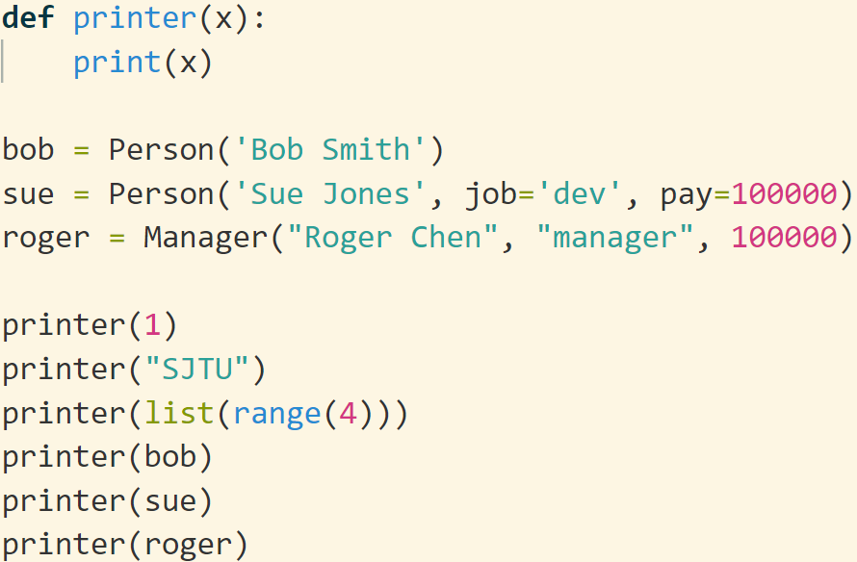
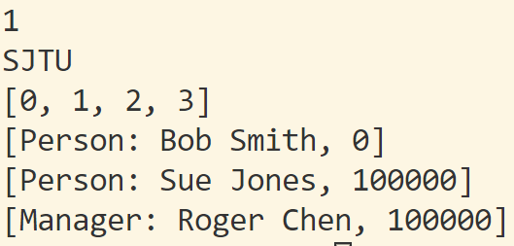
多态：根据不同的参数类型，运行时自动调用相应的方法，
不用重复编写相同的代码

Slide 42
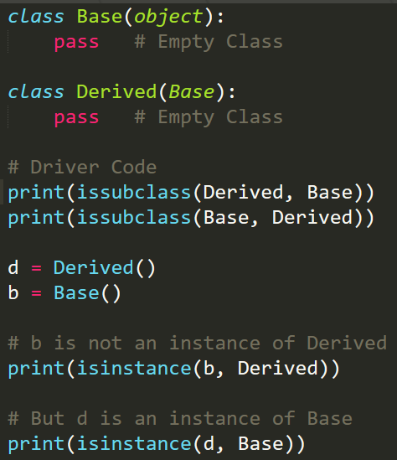

issubclass() and isinstance()
Python provides a function issubclass() that directly tells us if a class is subclass of another class. isinstance() will tell us if a variable is an object of a class

Slide 43








== VS. is
The == operator tests value equivalence. Python performs an equivalence test, comparing all nested objects recursively
The is operator tests object identity. Python tests whether the two are really the same object (i.e., live at the same address in memory)
is 依赖于系统

Slide 44


万物皆对象
函数是一个对象
dir(func)
func.__name__
func.__code__

Slide 45
object class
如何让自定义的类能够使用基本的运算符：
+,-,*,/, +=, >=, 等等
Python (from version 3.x), object is root of all classes.
https://docs.python.org/3/reference/datamodel.html
所有的类都继承了object类
类定义的头 class test, 其实是 class test (object):
object.__str__(self): Called by str(object) and the built-in functions format() and print() to compute the “informal” or nicely printable string representation of an object. The return value must be a string object
object.__lt__(self, other) # x<y lt: large than
object.__le__(self, other) # x<=y less equal
object.__eq__(self, other) # x==y equal
object.__ne__(self, other) # x!=y not equal
object.__gt__(self, other) # x>y greater than
object.__ge__(self, other) # x>=y greater equal
These are the so-called “rich comparison” methods. The correspondence between operator symbols and method names is as follows:
x<y calls x.__lt__(y), x<=y calls x.__le__(y), x==y calls x.__eq__(y),
x!=y calls x.__ne__(y), x>y calls x.__gt__(y), and x>=y calls x.__ge__(y)
object.__len__(self)

Slide 46



Triangle: overloading object

Slide 47


[]: __getitem__, __setitem__
How to access an element via its index
__getitem__(self, index)
__setitem__(self, index, value)

Slide 48


+, +=

Slide 49






Multiple inheritance 多重继承
仅供了解
Sub class may inherit several sup class
Chapter 31: Designing with Classes
P. 956 Multiple Inheritance: “Mix-in” Classes
Questions:
super()的困扰
A
B
C
MRO
D
BFS

Slide 50


repr(): __repr__(), __str__()
__str__() inside class X will be used for print(x)
__repr(object)__: Called by the repr() built-in function and by string conversions (reverse quotes) to compute the “official” string representation of an object
This is typically used for debugging, so it is important that the representation is information-rich and unambiguous.
In short, the goal of __repr__ is to be unambiguous and __str__ is to be readable.
如果没有定义__str__, 将自动使用__repr__
My rule of thumb: “__repr__ is for developers, __str__ is for customers.”
__repr__比__str__包含更多的信息
Repr：reproduce,包含更多信息
https://stackoverflow.com/questions/1436703/difference-between-str-and-repr
https://docs.python.org/3.8/reference/datamodel.html

Slide 51
Example
Triangle
Vector
Point2D
nDPoint
ComplexNumber
Happy Number
Isomorphic String
体会class的优点：代码界限清晰，互相不干扰；接口统一，配合方便

Slide 52
Reading
Learning Python: Part VI. Class and OOP
[]
for
……
Super() P. 1403
不需要死记，要用的时候再翻看手册

